Slide 1
Capstone Engagement
Assessment, Analysis, and Hardening of a Vulnerable System

Slide 2
Table of Contents
This document contains the following sections:
01
Network Topology
02
Red Team: Security Assessment
03
Blue Team: Log Analysis and Attack Characterization
Hardening: Proposed Alarms and Mitigation Strategies
04

Slide 3
Network Topology
‹#›

Slide 4
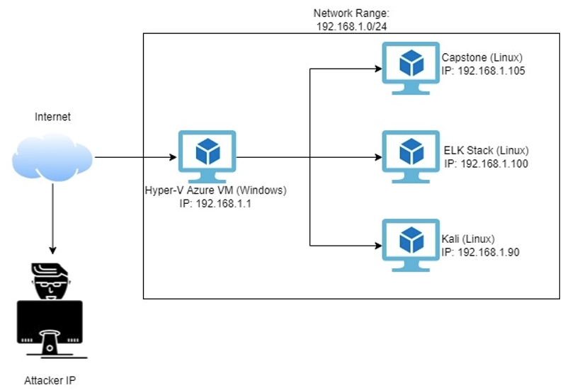
Network Topology
[Insert Here]
Use draw.io to create a diagram of the network.
Add your diagram to this slide and fill out the data in the sidebar.
Network
IP Range: 192.168.1.0/24
Netmask: 255.255.255.0
Gateway: 192.168.1.1
Machines
IPv4: 192.168.1.1
OS: Windows
Hostname: Hyper-V Azure VM
IPv4: 192.168.1.105
OS: Linux
Hostname: Capstone
IPv4: 192.168.1.100
OS: Linux
Hostname: ELK Stack
IPv4: 192.168.1.90
OS: Linux
Hostname: Kali

Slide 5

Red Team
Security Assessment
‹#›

Slide 6
Recon: Describing the Target
Nmap identified the following hosts on the network:
Hostname | IP Address | Role on Network
Hyper-V Azure VM | 192.168.1.1 | Host machine (cloud).
Capstone | 192.168.1.105 | Target machine. Includes Filebeat and Metricbeat.
ELK Stack | 192.168.1.100 | Network monitoring machine. Includes the Kibana dashboard.
Kali | 192.168.1.90 | Attacking machine.

Slide 7
Vulnerability Assessment Part 1
The assessment uncovered the following critical vulnerabilities in the target:
Vulnerability | Description | Impact
CWE-200 (Sensitive Data Exposure) | This occurs when sensitive information is exposed mistakenly by an organization. | This provides the first step into breaking into the webserver as it led to clues to dig deeper.
CWE-328 (Weak Hash) | A weak hash is one that uses an algorithm that is cryptographically broken, which makes it easy to decrypt. | With the hash being weak, crackstation.net is able to crack it. This allows access to the webserver.
CWE-434 (Unauthorized File Upload) | This vulnerability allows the upload of files by unauthorized users which can be used for nefarious reasons. | By being able to upload a file, I used a reverse shell script to give me root access.
CWE-521 (Weak Password Requirements) | Passwords were able to be bruteforced using common word lists. | With the password requirements being weak, it was easier to get into user accounts.

Slide 8
Vulnerability Assessment Part 2
The assessment uncovered the following critical vulnerabilities in the target:
Vulnerability | Description | Impact
CWE-548 (Exposure of Information Through Directory Listing) | This vulnerability is when a directory lists potentially sensitive information to attackers. | This vulnerability allowed me to view and access files within the directory providing webserver instructions.
LFI Vulnerability | LFI allows access into confidential files on a site. | An LFI vulnerability allows attackers to gain access to sensitive credentials
Root Access | Allows user to read and write any files on the system. Essentially allowed to do anything. | Gaining root let me search the entire webserver for secret information.
Weak Username | Usernames are simplistic, and can be guessed once you find a few. | Simple usernames provides more targets to attempt to bruteforce.

Slide 9
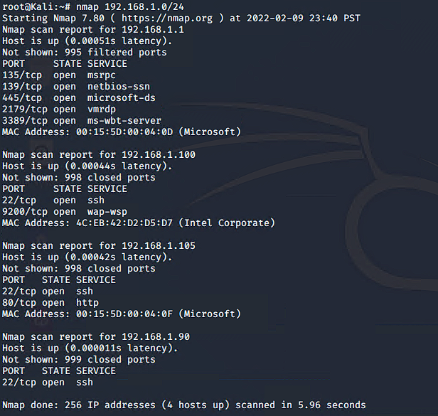
Exploitation: Sensitive Data Exposure (CWE-200) Part 1
1
2
3a
Tools & Processes
I used the command Nmap to find open ports and I was able to find an open port 80 on 192.168.1.105.
Achievements
What did the exploit achieve? For example: Did it grant you a user shell, root access, etc.?
Use nmap to find an open port 80.

Slide 10
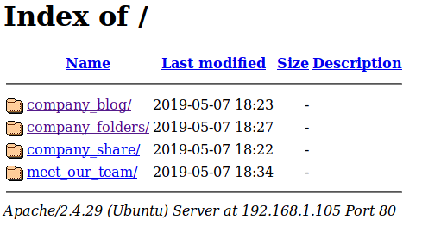
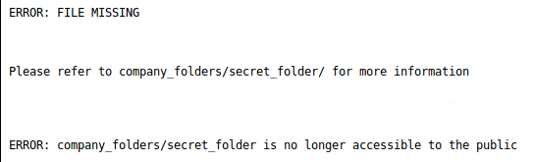
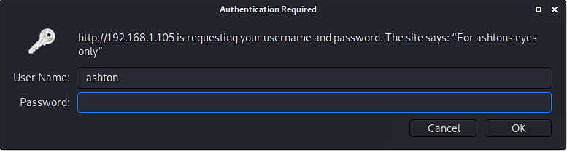
Exploitation: Sensitive Data Exposure (CWE-200) Part 2
01
3b
In a browser, use the URL: 192.168.1.105
Search the directory for secret information.
Now, use the URL to find the username:
192.168.1.105/company_folders/secret_folder/

Slide 11
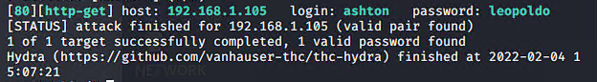
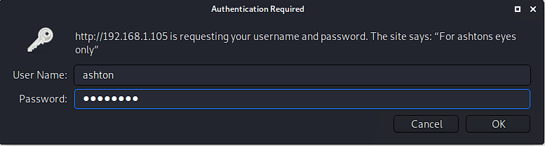
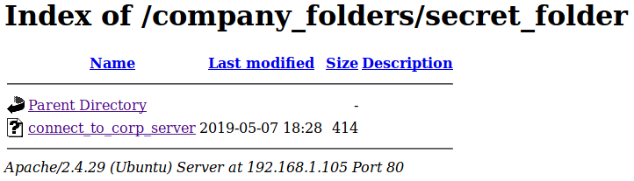
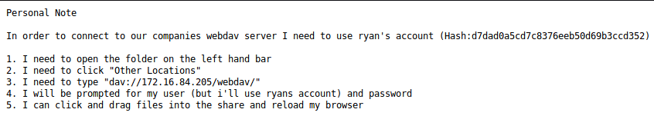
Exploitation: Bruteforce Vulnerability
1
2
3
Hydra command to bruteforce ashton’s password using a standard wordlist.
Tools & Processes
I used the tool Hydra and the word list rockyou.txt to bruteforce ashton’s password.
Achievements
This provided the login information to access the secret folder. Once inside, I found a hash and instructions on how to login to the webserver.
Hydra Results
Login Into: 192.168.1.105/company_folders/secret_folder/
Click the secret file for webserver login instructions

Slide 12
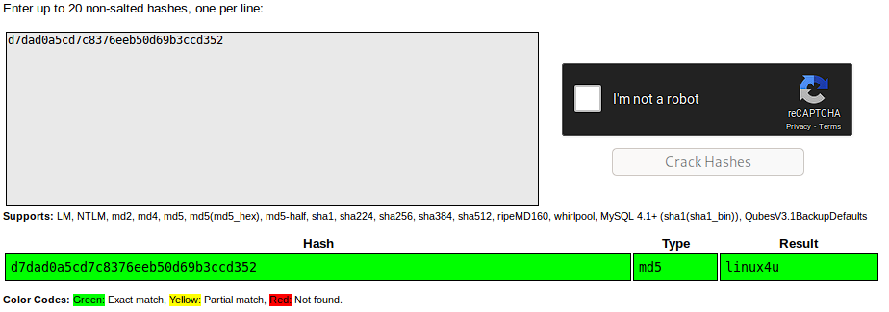
Exploitation: Weak Hash (CWE-328) Part 1
1
2
3a
Tools & Processes
The tool I used to crack the found hash was crackstation.net.
Achievements
This exploit provided access to the WebDAV webserver.
Login and Copy Hash From: 192.168.1.105/company_folders/secret_folder/connect_to_corp_server
Go to https://crackstation.net and paste hash to crack.

Slide 13
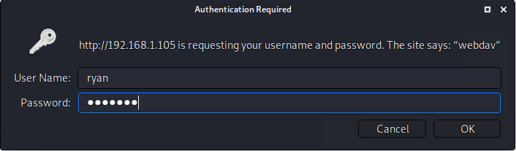
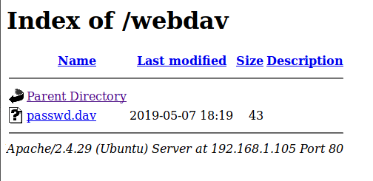
Exploitation: Weak Hash (CWE-328) Part 2
3b
Using the password, login to WebDAV:
http.192.168.1.104/webdav

Slide 14
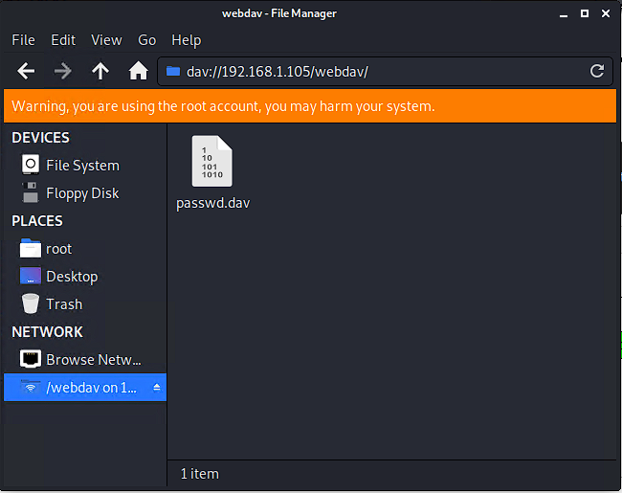
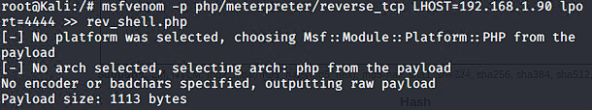
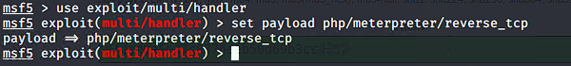
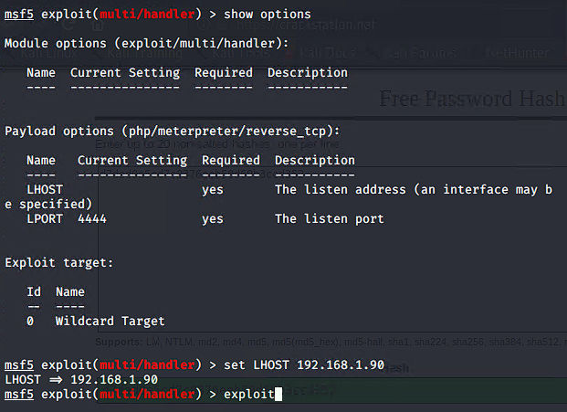
Exploitation: Unauthorized File Upload (CWE-434) Part 1
1
2
3a
Tools & Processes
The tool I used for this was msfvenom to create the reverse shell.
Another tool used was MetaSploit allowing me to select payloads and use it on the targeted machine.
Achievements
This exploit gave me root access allowing me to find secret files. In this case, I was able to find the secret flag.
In the application Browse Network, use the URL:
dav://192.168.1.105/webdav
Use the msfvenom command below to create script.
Use the following commands to set up payload and use it

Slide 15
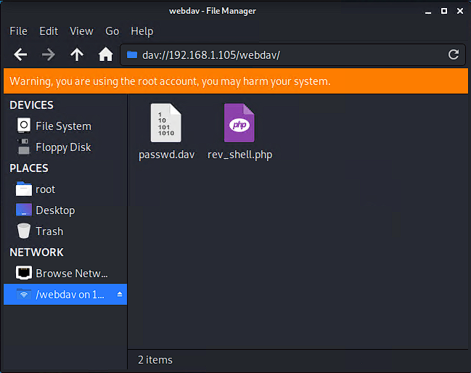
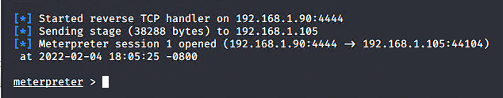
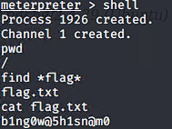
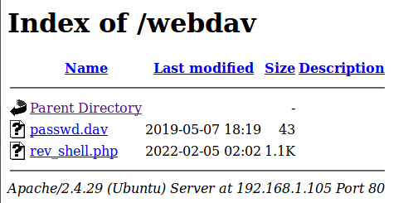
Exploitation: Unauthorized File Upload (CWE-434) Part 2
01
3b
3c
Place the reverse shell onto webdav directory.
On the listener, it should now be connected.
After typing the command shell, you have root access and can use commands to find hidden information (flag)
Login with Ryan’s credentials on:
192.168.1.105/webdav
Click rev_shell.php

Slide 16

Blue Team
Log Analysis and Attack Characterization
‹#›

Slide 17

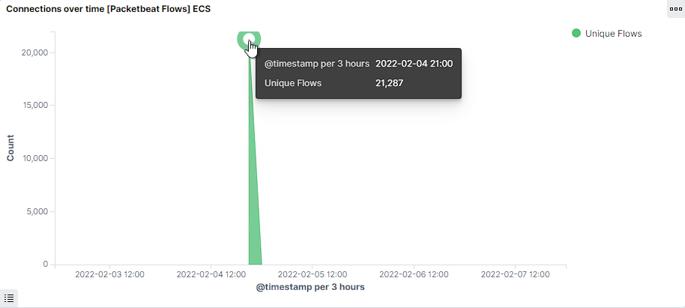
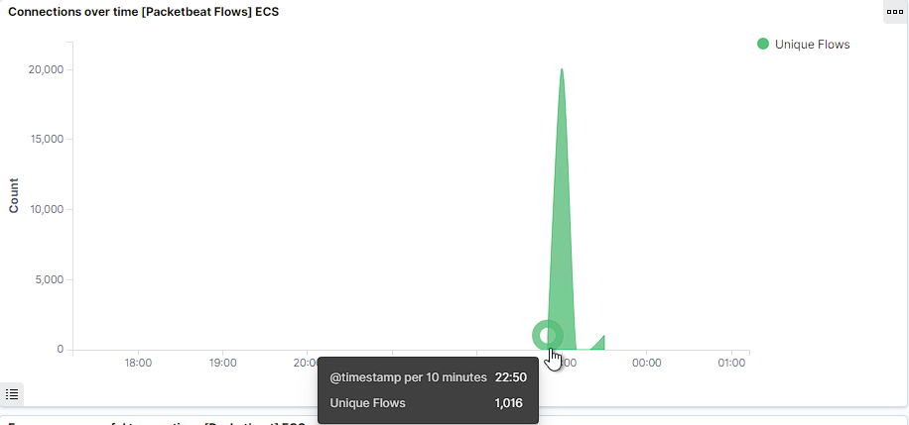
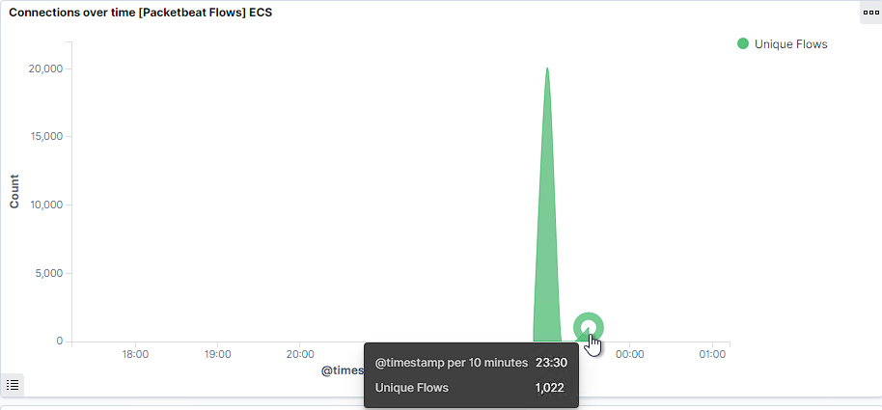
Analysis: Identifying the Port Scan
Answer the following questions in bullet points under the screenshot if space allows. Otherwise, add the answers to speaker notes.
The port scan occurred: 02/05/2022 at 22:50 – 23:30.
21,287 packets were sent from 192.168.1.90.
The sudden peaks of traffic shows this is a port scan.
[Insert Here]
Include a screenshot of Kibana logs depicting the port scan.

Slide 18
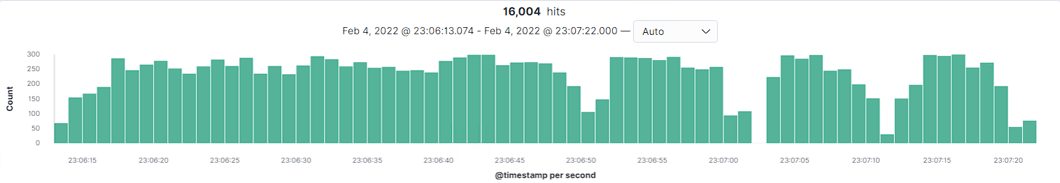
Analysis: Finding the Request for the Hidden Directory
Answer the following questions in bullet points under the screenshot if space allows. Otherwise, add the answers to speaker notes.
There were 16,004 made on 02/04/22 23:06:13 – 23:07:22
The /connect_to_corp_server was requested and contained login
information to connect to their webserver.
[Insert Here]
Include a screenshot of Kibana logs depicting the request for the hidden directory.

Slide 19
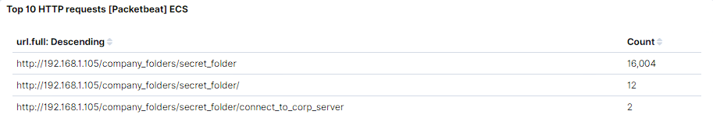
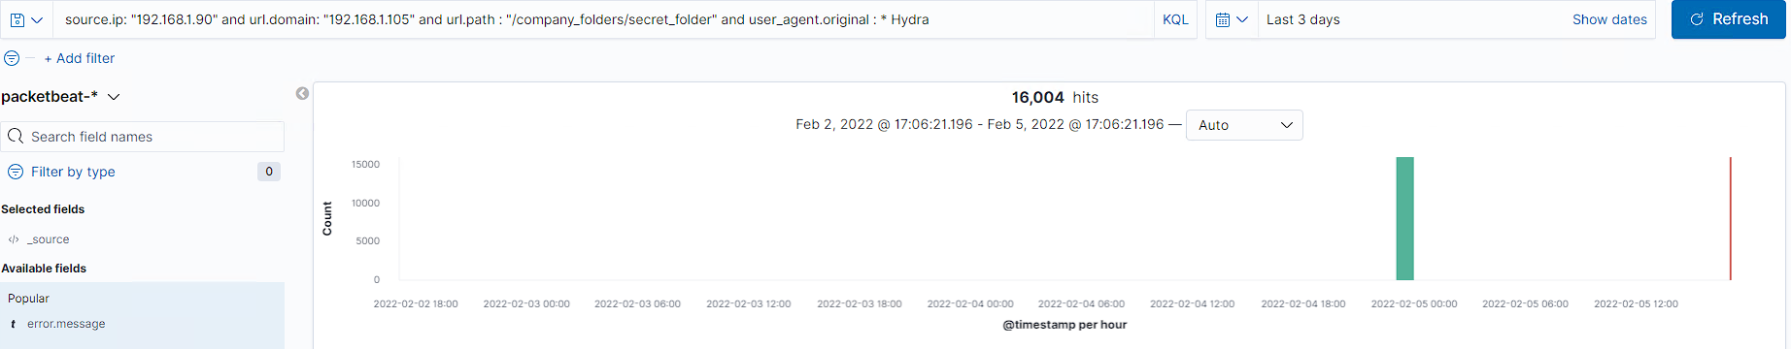
Analysis: Uncovering the Brute Force Attack
Answer the following questions in bullet points under the screenshot if space allows. Otherwise, add the answers to speaker notes.
There were 16,004 requests in the attack.
There were 16,003 requests before the password was cracked.

Slide 20
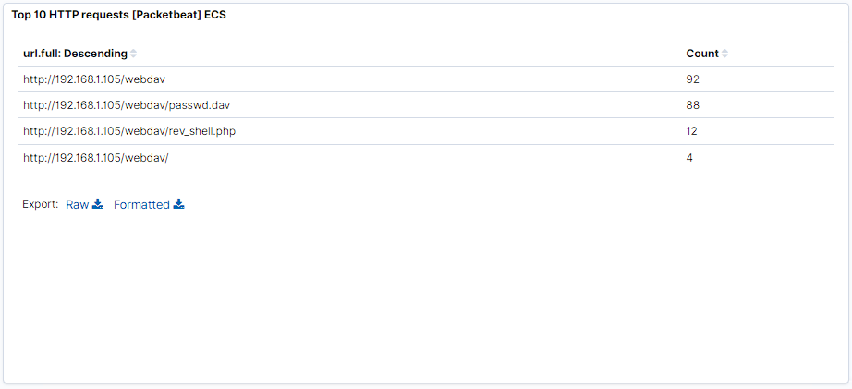
Analysis: Finding the WebDAV Connection
Answer the following questions in bullet points under the screenshot if space allows. Otherwise, add the answers to speaker notes.
There were 92 requests to this directory.
/webdav/passwd.dav was requested 88 times.
/webdav/rev_shell.php was requested 12 times.

Slide 21
Blue Team
Proposed Alarms and Mitigation Strategies
‹#›

Slide 22
Mitigation: Blocking the Port Scan
I would create an alert that notifies IT administrators when the packet count exceeds the threshold within 10 minutes.
Threshold: 1,000
Setup a Firewall that will prevent any unauthorized access to the network.
Firewalls also detect/prevent port scans.
Keep software up to date and regularly scanned for patchable vulnerable abilities to keep unauthorized access to a minimum.
Have regularly scheduled internal port scans to make sure nothing is set wrong.

Slide 23
Mitigation: Finding the Request for the Hidden Directory
I recommend creating an alert to notify IT administrators when any user tries to access this directory.
Threshold: 3
I would also set an alert when any user besides an IT administrators accesses the directory.
Threshold: 1
I’d create an alert when any IP outside the company’s region tries to access the directory.
Threshold: 1
Any files that contain sensitive information should not be publicly accessible. If it has to be online, make sure its name is inconspicuous.
As an extra precaution, the file(s) should also be encrypted.
Require multi-factor authentication to access.

Slide 24
Mitigation: Preventing Brute Force Attacks
An alarm that I would recommend creating would be to notify the IT administrators when the HTTP status code is “401 Unauthorized Error” threshold is crossed.
Threshold: 3
I would also create the same alert, set to recognize when an account is locked.
Threshold: 5
Create a stronger password policy. One that requires frequent password changes and blacklists commonly used passwords.
Add an Account threshold policy.
Microsoft recommends 5 login failure attempts before locking.
Automatically block any IP address outside the organization's region(s).
Require multi-factor authentication to login.

Slide 25
Mitigation: Detecting the WebDAV Connection
I recommend creating an alert that notifies IT administrators when any IP address from outside the company’s region(s) tries to access the directory.
Threshold: 1
I would also create a general alert used to notify IT administrators when the directory is access by anyone past the threshold.
Threshold: 5
Require multi-factor authentication to access.
Require only IP addresses within a certain range to be able to access.
For remote use, a VPN could be applied to get within the required range.

Slide 26
Mitigation: Identifying Reverse Shell Uploads
I recommend creating an alert to notify IT administrators when any file is uploaded outside the organization’s region(s).
Threshold: 1
I’d also create an alert to notify IT administrators when any suspicious scripts, code, or file types are attempted to be uploaded.
Certain file types to look for could be: “.sh”, PHP, etc.
Threshold: 1
Require multi-factor authentication to upload files.
Limit the the types of files that can be applied.
Only allow what users need.
Only allow IP addresses within a range to be able to upload.
For remote workers, a VPN can be setup and used to get within the range.

